Slide 1
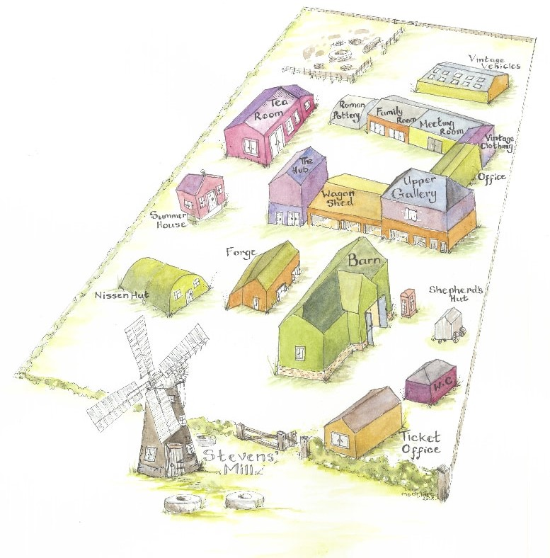
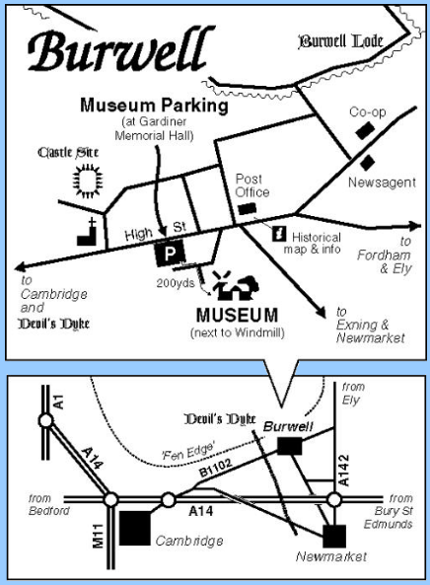
About the Museum
Burwell Museum and Windmill is a museum of Fen Edge Village Life, displaying artefacts which tell the history of Burwell from Anglo-Saxon times. Burwell is 30-45 minutes’ drive from Cambridge and 15 minutes from Newmarket.
The museum is only open to the public on Thursdays and Sundays, so your school group will have exclusive use of the site on any other day.
Our covered cafe is an ideal place to eat your lunch. Do be aware that we only have three toilets, so plan accordingly – it is possible to accommodate a group of 60 but not if they all try to go at the same time!
Unfortunately our museum parking is not suitable for coaches (minibuses will fit) but drivers can find space to park in the rest of the village. Please be considerate to our neighbours and avoid staying in Mill Close for long periods of time.
We are proud to be an Arts Award and Artsmark supporter: if you would like to discuss working towards the Discover Arts Award or your school’s plans for Artsmark please let us know.
Tel: 01638 605544
education@burwellmuseum.org.uk

Slide 2
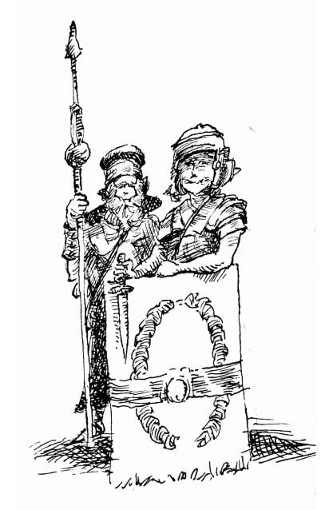
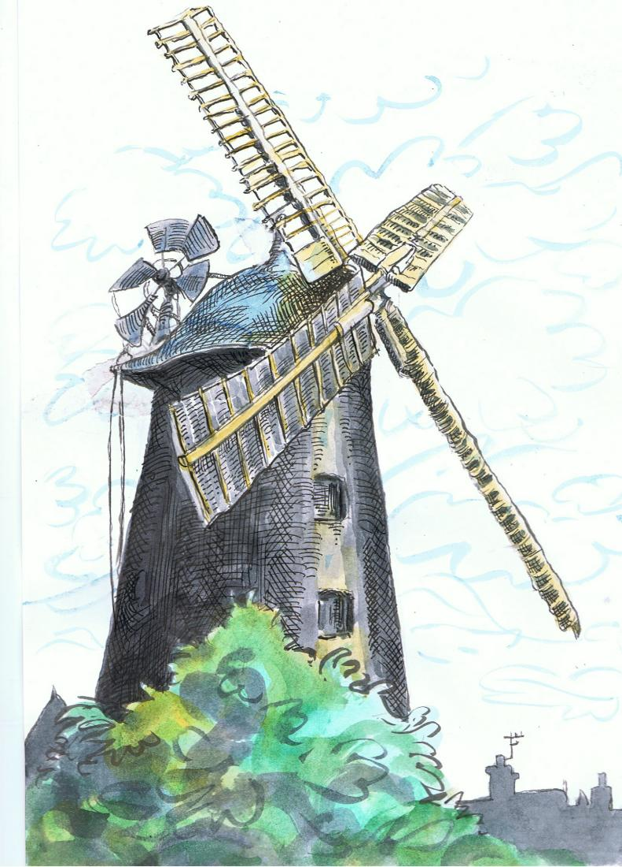
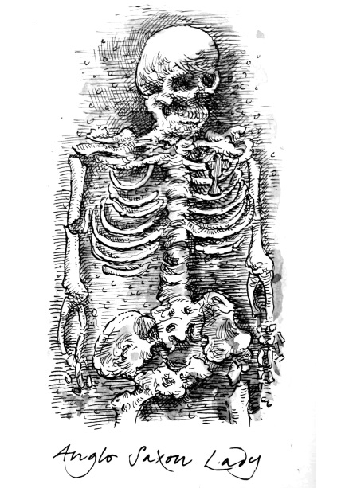
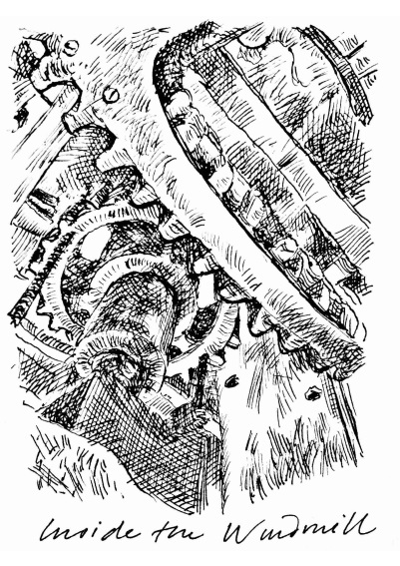
Burwell Museum
EYFS/KS1 Programme 2018-19
Contact Tel: 01638 605544
E-mail: education@burwellmuseum.org.uk
Website: www.burwellmuseum.org.uk
Mill Close, Burwell
Cambridgeshire, CB25 0HL

Slide 3
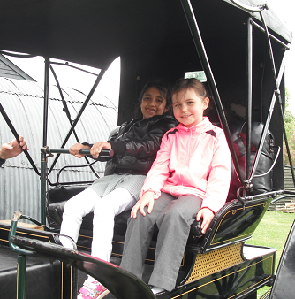
Early Years/Reception Meet the Museum (2hrs)
Find out more about what a museum is and
the people who work here. Explore the inside of the
windmill with our volunteers, take part in an object handling
session and ask lots of questions!
Little Red Hen (2hrs)
Meet Little Red Hen and her farmyard friends as they grow, make and mill their own flour from scratch. Hear a story, visit the windmill and see farming tools from the past. Handle wheat and other windmill artefacts.
Mrs Mopple’s Washing Line (2hrs)
Explore homes from the past with a costumed storyteller. Dress-up, wash clothes the old-fashioned way and explore the museum with a picture trail.
Year 1
Toys
What’s in Granny’s attic? (2hrs or full day) History/English
Explore Granny’s dusty boxes full of typical toys from the early, mid and late 20th century and enjoy object handling, play, photos and dressing-up. Then visit a 1950s school and village shop and play ‘I-spy’ in a 1930s house . In the afternoon make a mini suitcase of memories and toys to take home.
Everyday Materials : What’s this made of? (2hrs) Science/History
At the Museum
Half Day (2hrs) £2.50 per child Full Day £3.50 per child
Find out about the inventors and farmers of the past and how they chose their materials by exploring the windmill and our collections. Group objects according to what they are made out of, explain why different tools are made of particular materials and design your own marvellous milling machine.

Slide 4
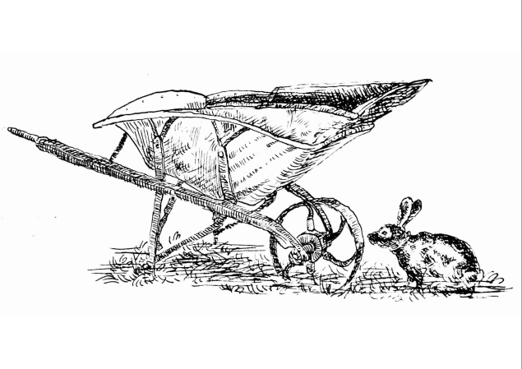
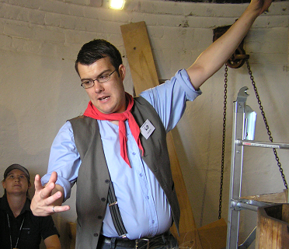
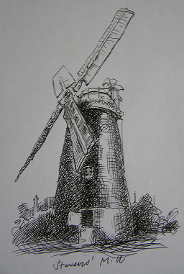
Year 2
Farming and Food (2hrs or full day)
History/Science/English/Drama/Music
Hands-on experience of fenland farming and food production. Dress up and role play village characters from 1900, handle real objects and find out how flour is made.
A full day ends with fenland folk stories, songs and dancing inspired by the farming year.
A Mill for All Seasons (2hrs) History/Science
.
How does a windmill work? Explore the forces needed to turn the sails, grind flour and move heavy objects around. Handle objects to find out how flour is made, design your own windmill and make flour using a hand quern.
Can’t get to the museum?
Our loans boxes contain a selection of original and reproduction objects, display materials and activity ideas. The cost is £5 per week or £15 for one month.
Toys
Burwell Life (Victorian)
We also offer outreach sessions, which can be based on any of the museum sessions or
tailored to meet your needs, for £30 per hour of teaching time or £120 for a day
(max.6hours including breaks). To book or discuss an outreach session, please contact
Alison Giles, our Education Officer, at education@burwellmuseum.org.uk

